Slide 1

IMPLEMENTING NETWORK SECURITY WITH ACL’S AND NAT
Supervised by: Eng Khaled Abd Rabo

Slide 2

MEET THE TEAM :
MAZEN TAREK(TEAM LEADER)
Project management
ACL’s
troubleshooting
ADEL MOHAMMED
NAT
ACL’s
troubleshooting
Security Assessment
NAT
Documentation
MOHAMMED GAMAL
YOUSSIF ALY
ACL’s
Presentation
Network Design
PETER SAMIR
Network Design
Documentation
MAHMOUD RAGAB
Presentation
Network Design

Slide 3


TODAY'S AGENDA
1
Introduction
6
Network Behavior
2
Time Line
7
Problem Statement
3
Network Design
8
Conclusion
4
Network Components
5
Configuration Details

Slide 4

INTRODUCTION :
Implementing Network Security with ACLs and NAT, focuses on enhancing network security by using Access Control Lists (ACLs) and Network Address Translation (NAT). The goal is to secure internal resources while allowing controlled access to external networks. This project was structured into four weeks, where each phase built upon the previous to create a secure and manageable network infrastructure.

Slide 5

TIME LINE :
week 1
week 2
week 3
week 4
Configuration of Standard and Extended ACLs to control traffic flow and manage access to network resources.
Implementation of NAT to manage IP address translations.
Integration of ACLs and NAT with a thorough security assessment.
Documentation of findings, configuration details, and network performance improvements.

Slide 6
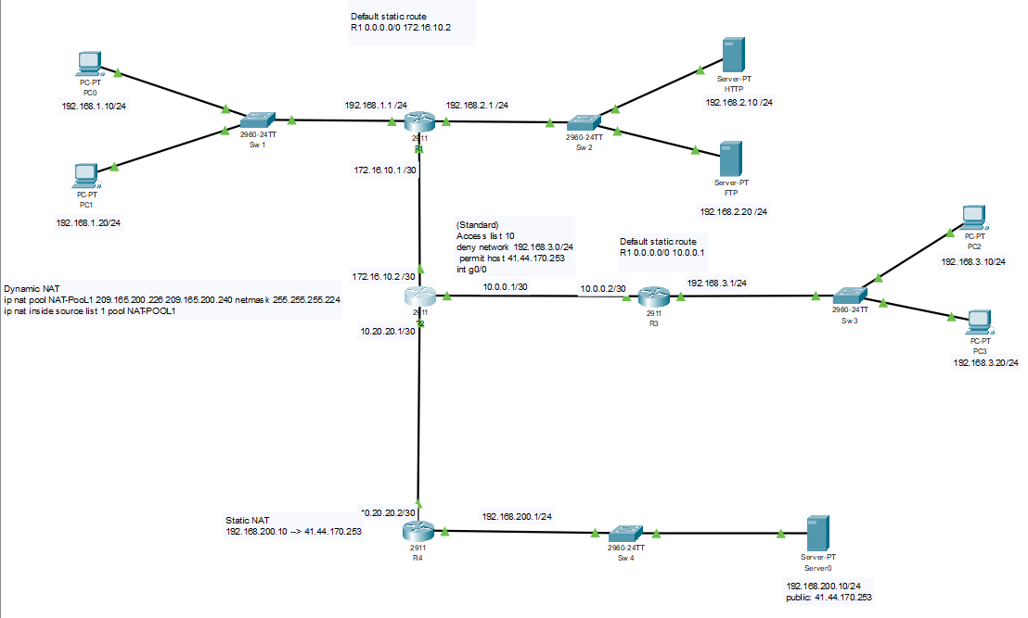
NETWORK DESIGN :

Slide 7
PCs:
- PC0: 192.168.1.10/24
- PC1: 192.168.1.20/24
- PC2: 192.168.3.10/24
- PC3: 192.168.3.20/24
Servers:
- HTTP Server: 192.168.2.10/24
- FTP Server: 192.168.2.20/24
- Server2 192.168.200.10/24 (Mapped to Public IP: 41.44.170.253)
NETWORK COMPONENTS:

Slide 8
Routers:
R1:
- Gig0/0: 192.168.1.1/24
- Gig0/1: 172.16.10.1/30
- Gig0/2: 192.168.2.1/24
- Static Route: 0.0.0.0/0 → 172.16.10.2
R2:
- Gig0/0: 172.16.10.2/30
- Gig0/1: 10.0.0.1/30
- Gig0/2: 10.20.20.1/30
- **Dynamic NAT Pool**: 209.165.200.226 - 209.165.200.240
R3:
- Gig0/0: 10.0.0.2/30
- Gig0/1: 192.168.3.1/24
- **Static Route**: 0.0.0.0/0 → 10.0.0.1
R4:
- Gig0/0: 10.20.20.2/30
- Gig0/1: 192.168.200.1/24
- Static NAT: 192.168.200.10 → 41.44.170.253 (Public IP)
NETWORK COMPONENTS:
Switches:
- Sw1: Connected to PC0, PC1, and R1.
- Sw2: Connected to HTTP and FTP servers (Server0 and Server1).
- Sw4: Connected to public server (Server2) and R4.

Slide 9
CONFIGURATION DETAILS:
WEEK 1: ACL CONFIGURATION
Task: Implement ACLs to control traffic and secure network access.
Standard ACL 10 (on Router R3):
Extended ACL 100 (on Router R1):
- Denies access to internal network (192.168.3.0/24).
- Allows other traffic from public sources.
- Allows PC0 and PC1 to communicate with the HTTP server (192.168.2.10) but only PC1 can communicate with the FTP server (192.168.2.20).
- Restricts access to other services for internal security.

Slide 10
CONFIGURATION DETAILS:
WEEK 2: NAT IMPLEMENTATION AND TESTING
Task: Implement NAT (Static and PAT) for IP address management and security.
Dynamic NAT: Configured on Router R2 using a pool of public IPs (209.165.200.226 - 209.165.200.240). This allows internal users from any LAN to access the internet using an external public IP address.
Static NAT: Configured on Router R4 to map the internal server (192.168.200.10) to a public IP address (41.44.170.253). This enables public access to the server while protecting the internal network.

Slide 11
CONFIGURATION DETAILS:
WEEK 3: INTEGRATION AND SECURITY ASSESSMENT
Task: Integrate ACLs and NAT into the network and perform a security assessment.
- Integration: The ACLs and NAT were integrated, ensuring that:
- PC0 and PC1 can access the HTTP server.
- Only PC1 has access to the FTP server.
- PCs from LAN 3 (PC2 and PC3) can only access the internet and not internal resources.
- External entities are denied access to LAN1, HTTP, and FTP servers.
-Security Assessment: Conducted to evaluate potential vulnerabilities. The assessment showed that unauthorized access attempts to internal resources were blocked, ensuring that the network adhered to security best practices.
Overall all security measurements were checked.

Slide 12
CONFIGURATION DETAILS:
WEEK 4: DOCUMENTATION AND FINAL PRESENTATION
Task: Document the entire project, including configurations, improvements, and performance analysis
Final Report: Detailed the configuration of ACLs and NAT, integration results, and overall security improvements. Specific areas of improvement included enhanced access control for internal users and isolation of guest network segments

Slide 13
NETWORK BEHAVIOR:
LAN 1 (PC0, PC1):
- PC0 can access the HTTP server.
- PC1 can access both HTTP and FTP servers.
- Both PCs are restricted from allowing outsiders into LAN 1.
LAN 3 (PC2, PC3:
- PCs are isolated and can only access the internet (no internal resources).
- Internet Access:
- All users from any LAN can access the internet via the NAT setup
LAN 2 Public Server (Server2 the internet) :
- External users can access Server2 (mapped via static NAT to public IP 41.44.170.253).

Slide 14
CONCLUSION :
This project successfully demonstrated the implementation of ACLs and NAT to enhance network security. By controlling traffic using ACLs and managing public IP addresses with NAT, the network was secured against unauthorized access, while allowing controlled access to necessary resources. The final security assessment confirmed the effectiveness of the implemented solutions, ensuring that internal network resources were protected while maintaining efficient network performance

Slide 15
BIG THANKS
To our instructor Khaled Abd Rabo
& DEPI

